Slide 1

ASP.NET 4.5 Developer Preview
Jon Galloway
http://weblogs.asp.net/jgalloway
SoCal Code Camp

Slide 2
Agenda
Overall focus areas for ASP.NET 4.5
ASP.NET 4.5 Web Forms
Common features
Where to find more

Slide 3
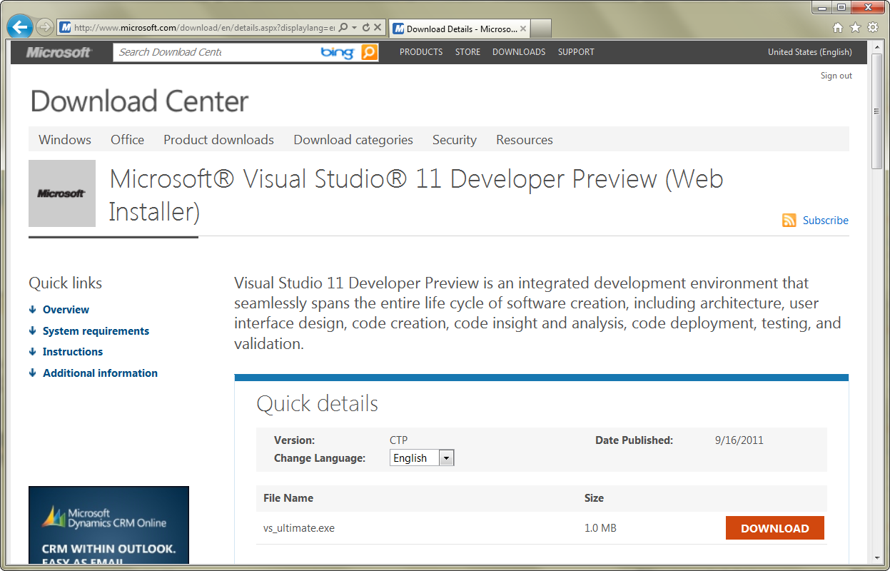
Visual Studio 11

Slide 4
ASP.NET 4.5 Web Forms
Data
Strongly typed binding
Attributed models (and their advantages)
Model binding
HTML5
HTML Encoding

Slide 5
ASP.NET Core
Caching
Modules
Globalization
Pages
Controls
Master Pages
Profile
Roles
Membership
Intrinsics
Handlers
etc.

Slide 6
Web Forms
MVC
Web Pages
ASP.NET Core
.NET Runtime

Slide 7




Data in ASP.NET MVC
What does MVC look like?
Request
Controller
Controller
Retrieves Model
“Does Stuff”
View
View
Visually represents
the model
Response
Notes:
Estimated Time: 4 minutes
So what does MVC look like when implemented over the web?
When an HTTP request comes into the application it is mapped to a controller. Remember as we mentioned in the previous slide, in the MVC design pattern, the controller is the piece of the trifecta that handles all user input. In the case of a web application, user input is represented as HTTP requests [Advance Animation].
Once the controller has received input, it performs whatever operations it needs to and then assembles a presentation model [Advance Animation].
The controller then takes the model and passes it off to the view. Remember that the view is simply a visual representation of the model [Advance Animation].
The view then “transforms” the model into whatever format it uses to represent it. In a web application, this would typically be HTML [Advance Animation].
The view then serves the request by responding with its visual representation.

Slide 8
Data access paradigms
Database First
Model First
Code First
Start with schema, generate a model
Design a model, generate a schema and code
Code a model, generate a schema

Slide 9
ASP.NET 4.5 Web Forms
Data
Strongly typed binding
Attributed models (and their advantages)
Code-first
Dynamic Data aware
Easy to use unobtrusive validation
Model binding
HTML5
HTML Encoding

Slide 10
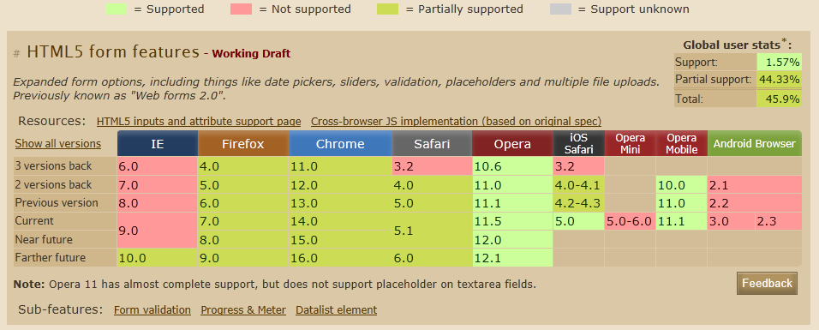
HTML5 Form Features

Slide 11
ASP.NET Common Features
Async
Bundling / Minification
Flexible Validation
Performance

Slide 12
Async Handlers / Modules
public class MyAsyncHandler : HttpTaskAsyncHandler
{
// ...
// ASP.NET automatically takes care of integrating the Task based override
// with the ASP.NET pipeline.
public override async Task ProcessRequestAsync(HttpContext context)
{
WebClient wc = new WebClient();
var result =
await wc.DownloadStringTaskAsync("http://www.microsoft.com");
// Do something with the result
}
}

Slide 13
ASP.NET Common Features
Async
Bundling / Minification
Flexible Validation
Performance

Slide 14
Where to find more
http://asp.net/vnext
http://www.microsoft.com/visualstudio/en-us/visual-studio-11

